Slide 1
Melbourne
Identifying optimal locations for food trucks operators using current and forecasted construction activity

Slide 2
Problem of lost hours
While coffee has shown to boost productivity, the coffee breaks are costing companies millions of dollars in lost hours.
This problem is amplified for construction sites, which often do not have enough temporary structures to serve all people working on sites.
As a result, considerably amount of staff’s time is lost due to need to travel for coffee breaks, resulting in inflated project costs and timelines

Slide 3
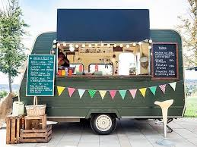
The Solution
As a solution, mobile food trucks can be positioned near construction sites to reduce the time spent on travelling to get coffee.
In addition to saving construction firms dollars, the above will also help food truck owners withstand competition from food delivery platforms.
The Construction workers will also benefit from ability to quickly obtain refreshments without having to travel or pay delivery fees.

Slide 4
Project objective
Identify construction clusters in Melbourne CBD and surrounding suburbs which do not have a café within 100 metres.
Also use insights of current and forecasted construction activity to identify potential sites for new / additional food venues.

Slide 5
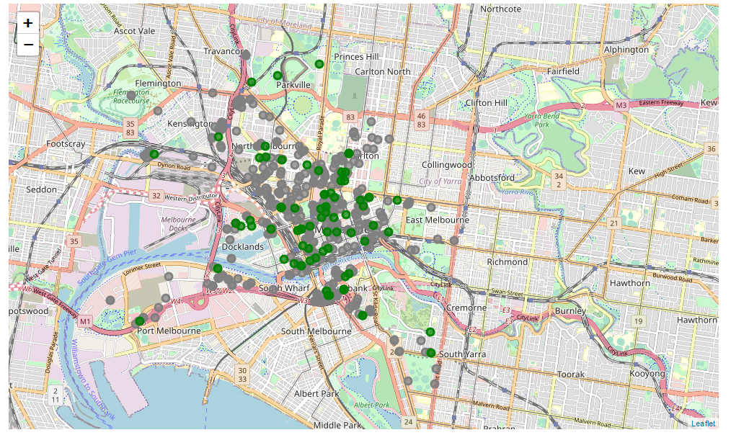
Melbourne Construction Activity
Current construction activity (green dots) is largely concentrated in the Melbourne CBD region.
North Melbourne is expected to witness an increase in construction activity given it has a large number of sites approved for developments (grey dots)

Slide 6
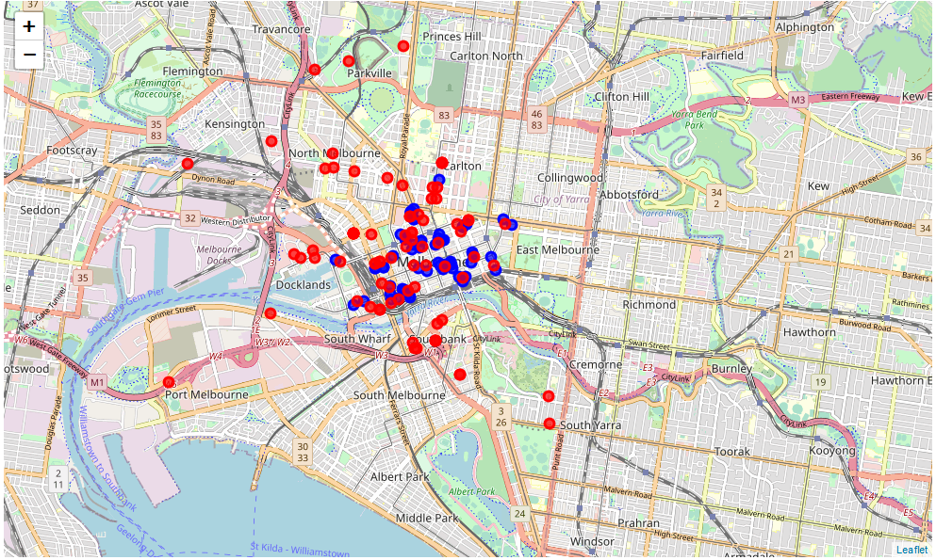
Live construction sites and Cafes
Construction sites (red dots) outside Melbourne CBD do not have cafes (blue dots) within 100 metres
These sites present an opportunity for food truck operators to suitably position their businesses to tap unmet demand.

Slide 7
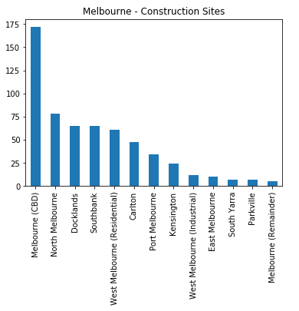
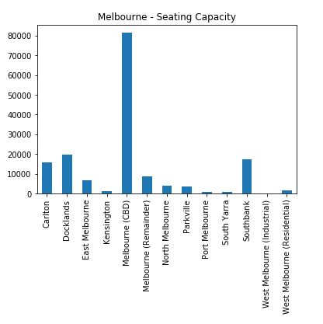
Seating capacity
Using construction activity as a proxy for growth and seating capacity as a proxy for number of restaurants, suburbs like North Melbourne and West Melbourne remain attractive geographies for addition of new food business venues.

Slide 8
Conclusion / findings
Melbourne CBD remains the hub of construction activity and has maximum seating capacity.
North Melbourne is poised to witness an increase in construction activity.
North Melbourne, Southbank, Parkville, South Yarra are some of the locations which food truck operators can tap for relatively easy business.
North Melbourne, Parkville and West Melbourne (Residential) remain attractive geographies for addition of new food venues.

Slide 9
Limitations / further research
The following are key limitations of the study, which also represent areas for further research:
Time
Lack of demographic data to identify cuisine of new food venues.
Limited information regarding size of construction sites.
Lack of data of exiting food truck operators in the region.

